Slide 1
SBA Loan Data Analysis Presentation
May 15. 2025
Eli Friedmann
State whether the information is confidential and how it's intended to be used.
Notes:
Slides are part of the deliverable.
Spreadsheet and project (slides, notebook, and references)
Add Name

Slide 2
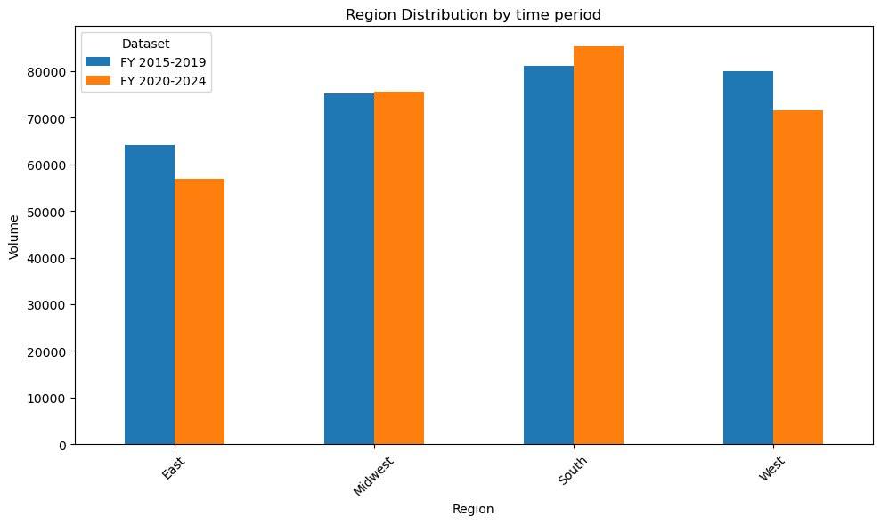
Regional Distribution
Relatively consistent by time period
More variability in the later time period

Slide 3
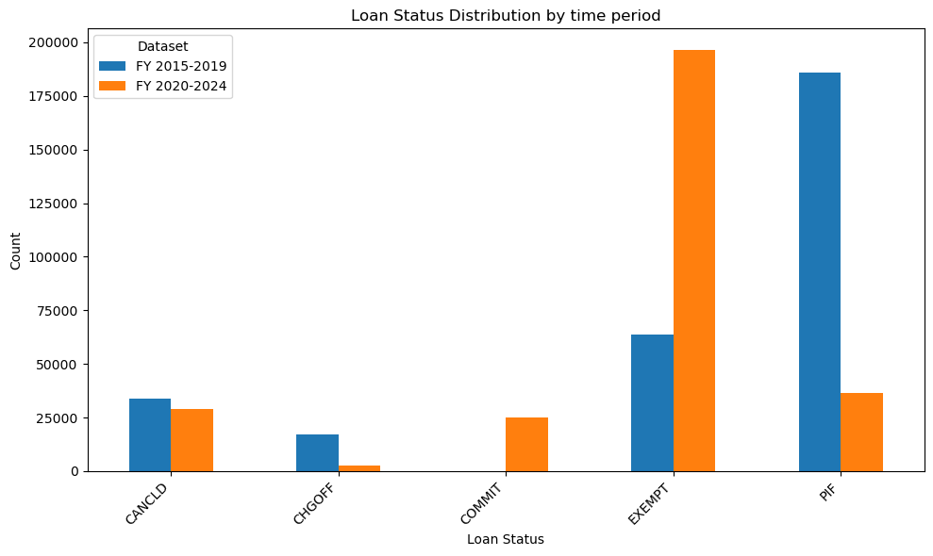
Loan Status Distribution
Relative consistency in number of Canceled loans from time period to time period
All undispersed come from latest time period
Most Paid in Full (PIF) comes from earlier time period
Most Exempt comes from later time period

Slide 4
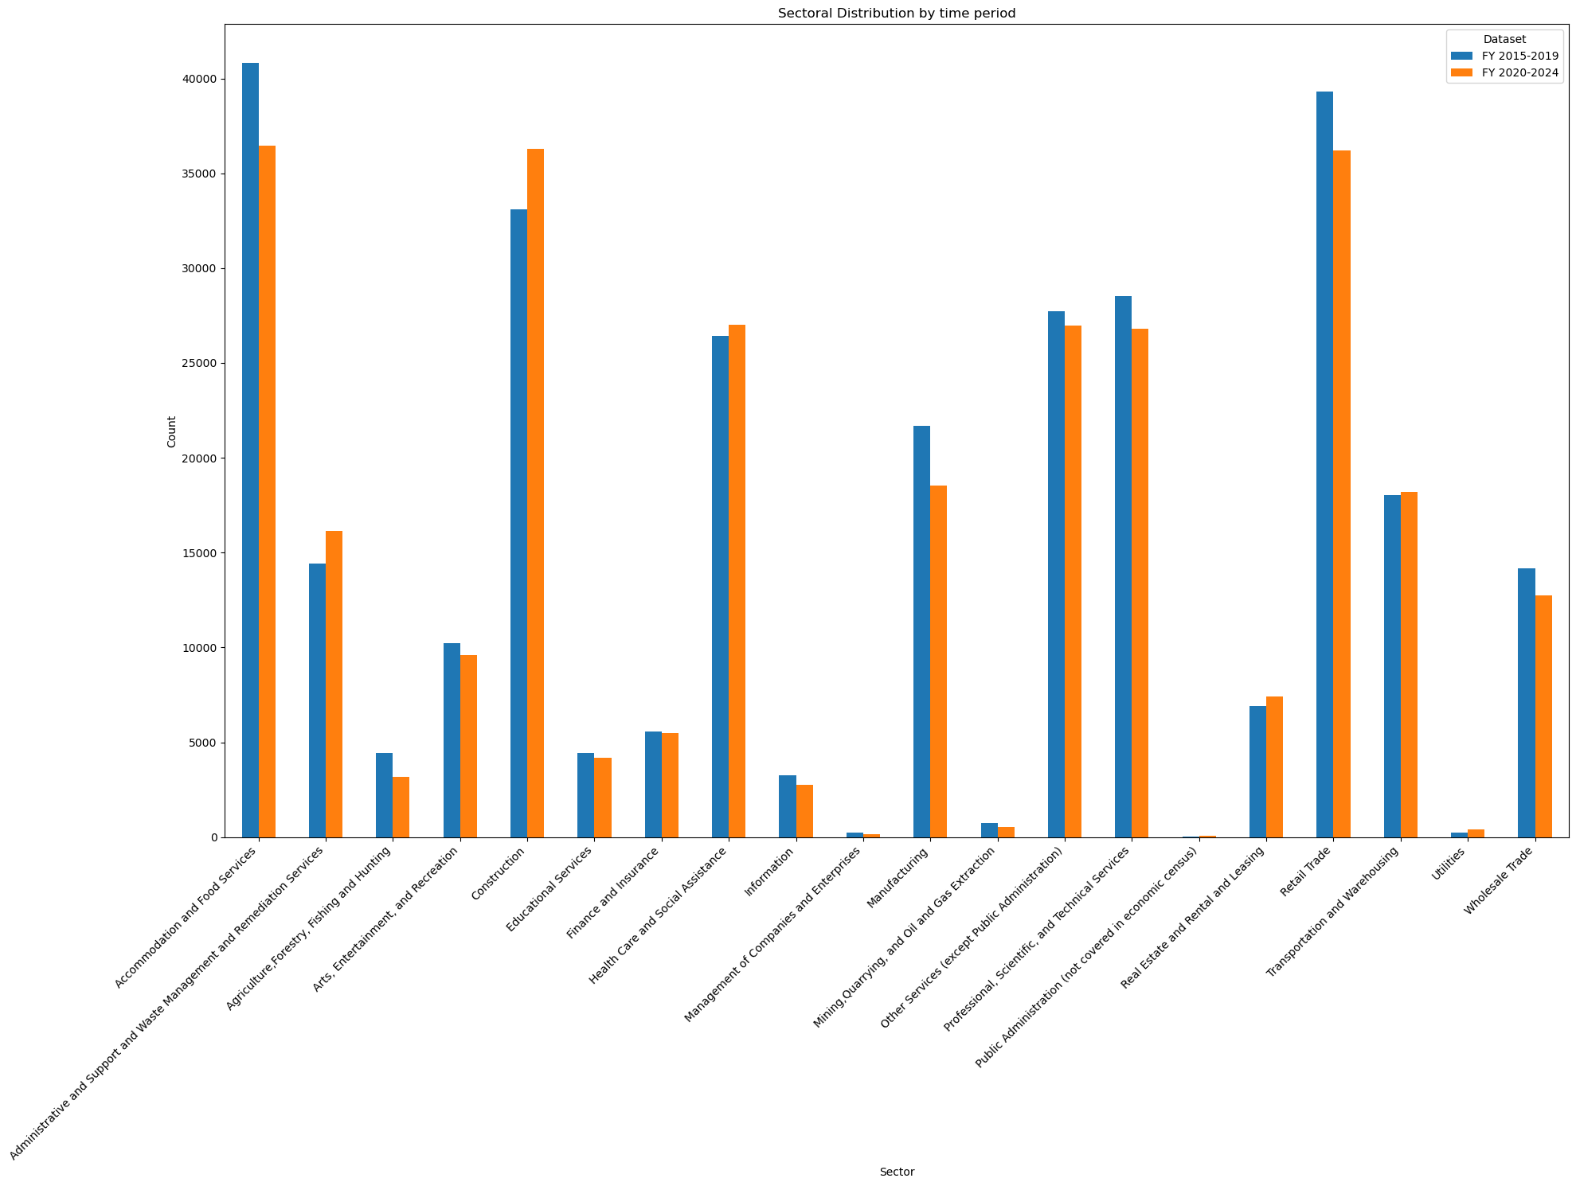
Sectoral Distribution
Food services, construction and retail are all similar in number for the later time period

Slide 5
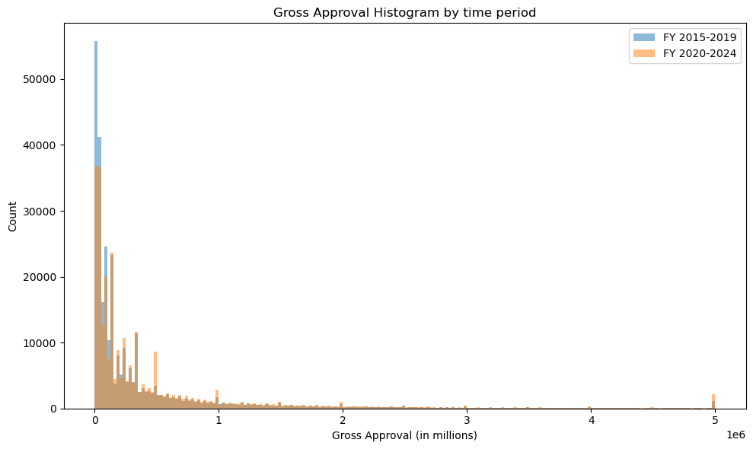
Gross Approval Histogram
After 500,000 distribution remains pretty consistent from the different time periods
More small dollar loans in the earlier period

Slide 6

Analyzing Loan Approval Trends
Rank all loans below $300,000 by loan count.
Compare 2015-2019 to 2020-2024 loan rankings.
Rank canceled loans under $300,000 by count.
Identify patterns among loan data fields.
Rank loans above $300,000 by loan count.
Notes:
No Change

Slide 7
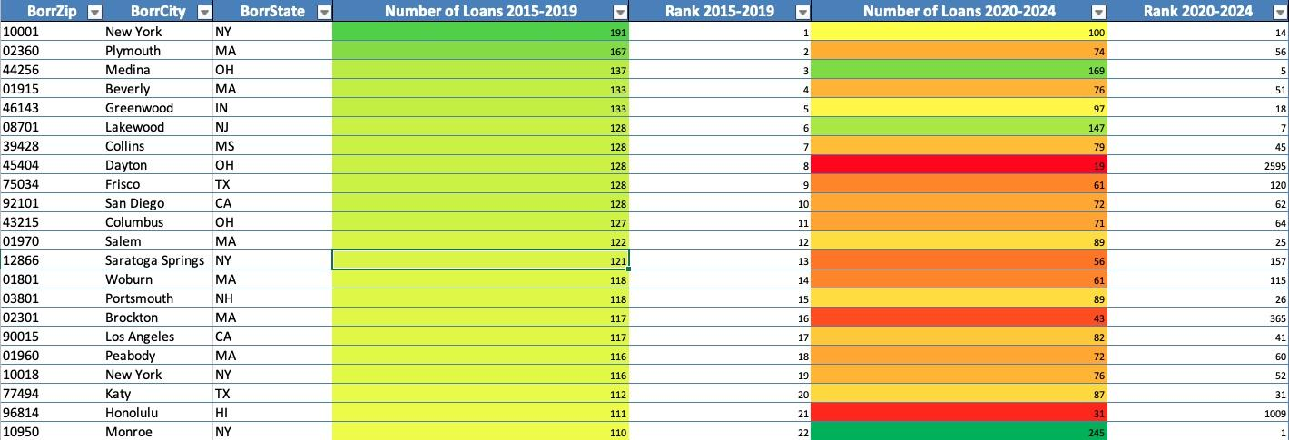
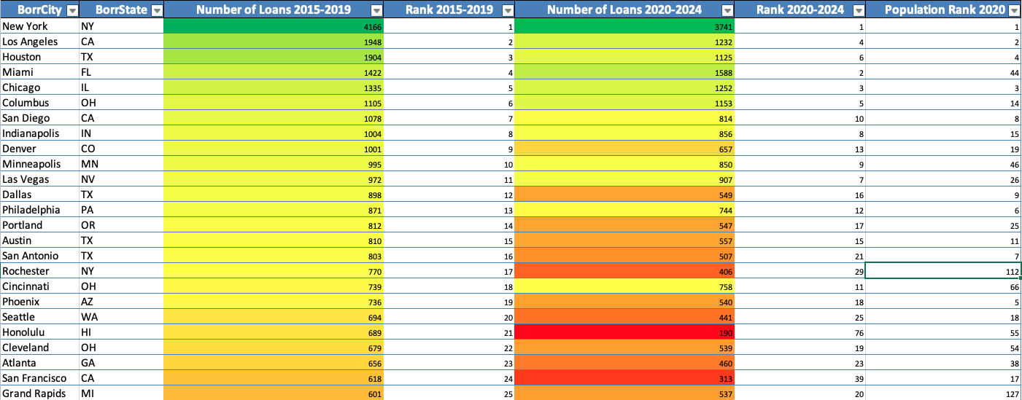
Location vs. Volume: Gross Approval < $300,000
Notes:
Change title
Break into two slides

Slide 8
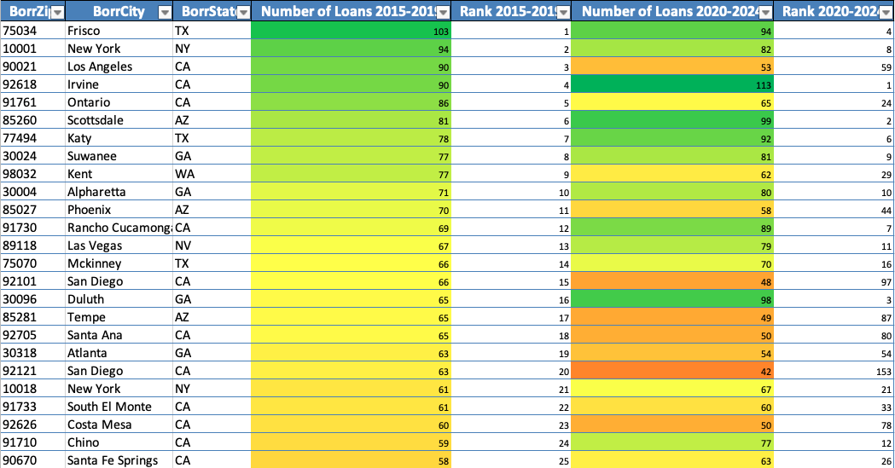
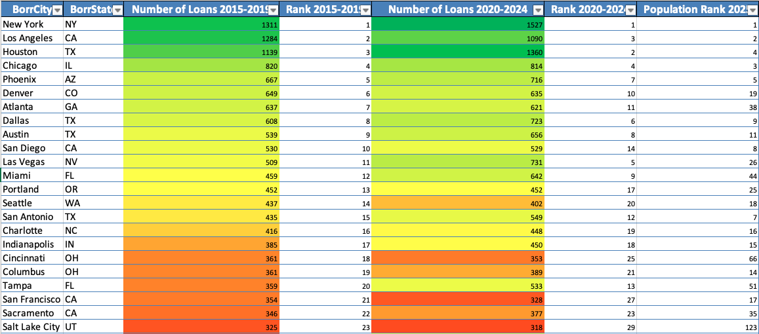
Location vs. Volume: Gross Approval >= $300,000
Notes:
Change title
Break into two slides

Slide 9
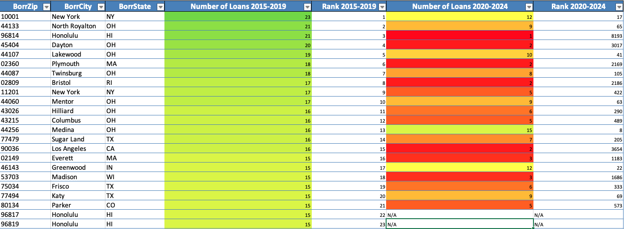
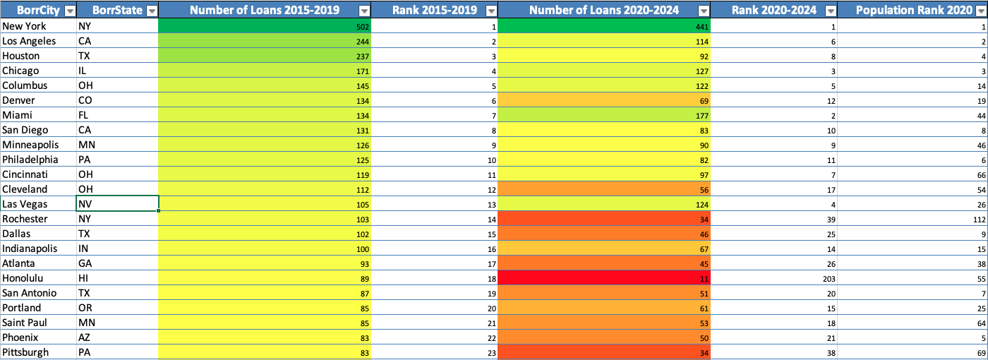
Location vs. Volume: Gross Approval < $300,000, Loan Status is Canceled
Notes:
Change title
Break into two slides

Slide 10
Data Models

